Slide 1
EGB1202 Python Programming
Academic Year: 2024 – 2025
II Year / III Semester
End Semester Review
Register Number : 927623BEE028
Name : ELAMURUGAN.M
Department : EEE

Slide 2
Title of the Project
Automatic Patient Management Systems

Slide 3
Abstract
The implementation of a comprehensive Patient Management System (PMS) is vital for enhancing healthcare delivery in today’s fast-paced medical environment. This system centralizes patient interactions, beginning with streamlined registration and data management, which allows healthcare providers to securely capture and access essential patient information.
The system also gathers and analyzes patient improvement data, allowing for tailored care interventions. Finally, automated discharge summaries ensure that patients receive clear follow-up instructions, promoting continuity of care. Overall, a Patient Management System not only streamlines operations but also elevates the quality of patient care, making it an essential asset for modern healthcare facilities.

Slide 4
Abstract with CO/PO Mapping
Abstract | CO | POs | PSO
The implementation of automatic Patient Management System (PMS) is vital for enhancing healthcare delivery in today’s fast-paced medical environment. This system centralizes patient interactions, beginning with streamlined registration and data management, which allows healthcare providers to securely capture and access essential patient information. | Co1 Co2 Co3 Co4 | Po1 Po2 Po3 Po4 po5 Po6 Po8

Slide 5
Introduction
In the rapidly evolving healthcare landscape, a comprehensive Patient Management System (PMS) has become essential for improving patient care and operational efficiency.
This system serves as a centralized platform for managing all aspects of patient interactions, beginning with patient registration and data management. By streamlining the onboarding process, healthcare providers can capture essential information securely.
To assess the effectiveness of care, the system gathers and analyzes patient improvement data, enabling healthcare providers to monitor progress and tailor interventions as needed. Finally, upon discharge, the PMS automates the generation of discharge summaries, providing patients with clear instructions on follow-up care and medications, thereby ensuring continuity in their healthcare journey.

Slide 6
CONCEPT Used
Classes and Objects
Constructor Method
Random Module
List Comprehensions
Control Flow
String Representation
User Input
Matrix Representation
Basic Exception Handling

Slide 7
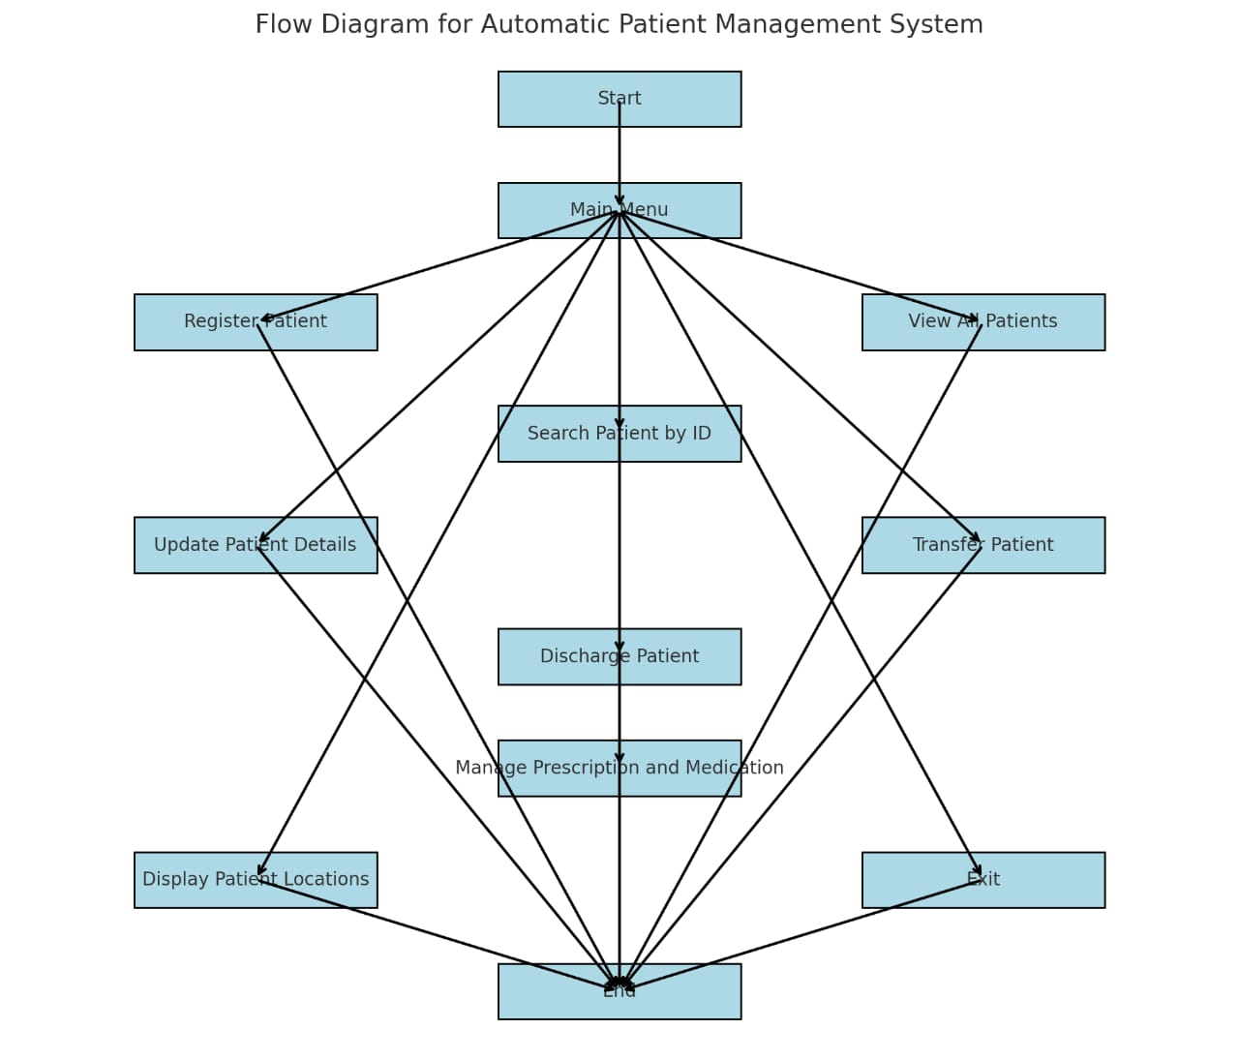
Proposed Architecture

Slide 8
Proposed Architecture - Description
1.Registering Patients: When a new patient arrives, the system collects their personal details like name, age, contact info, and assigned doctor. It then checks for an available room and assigns the patient a space. An appointment is scheduled for the patient, and their details are stored in the system.
2.Viewing and Searching Patients: Staff can view all registered patients or search for a specific patient by their ID. This allows easy access to a patient's details.
3.Updating Patient Details: If any patient information needs to be updated (such as a change in contact details or doctor), the system allows staff to make those changes.
4.Transferring Patients: If a patient needs to be moved to a different room, the staff can select a new room, and the system checks if it's available. If it is, the patient’s room assignment is updated.

Slide 9
Proposed Architecture - Description
5.Managing Prescriptions: Doctors or staff can add medications and injections to a patient's prescription. The system tracks the medications, dosages, and timings for each patient.
6.Discharging Patients: When a patient is ready to leave, the system generates a bill based on their stay duration, room charges, medications, and any other treatments. The patient is then discharged, and their room is marked as available again.
7.Room and Patient Location: The system also shows which rooms are occupied or empty, helping staff manage room assignments more efficiently.
8.Main Menu: All of these functions are available through a simple menu that guides hospital staff to perform their tasks in a straightforward way.

Slide 10
List of Modules
1. Patient Registration Module
2. Appointment Scheduling Module
3. Prescription and Medication Management Module
4. Discharge and Transfer Module
5. Patient Feedback and Satisfaction Module

Slide 11
Module Description
1. Patient Registration Module :
Collects and manages patient details like name, age, contact information, and medical history.
2. Appointment Scheduling Module :
Manages patient appointments with doctors, reminders, and availability of medical personnel.
3. Prescription and Medication Management Module :
Automates prescription issuance, medication tracking, and refills.
4. Discharge and Transfer Module :
Manages patient discharge procedures, transfers between departments, and follow-up care plans.
5. Patient Feedback and Satisfaction Module :
Collects patient feedback on services and provides reports on patient satisfaction.

Slide 12
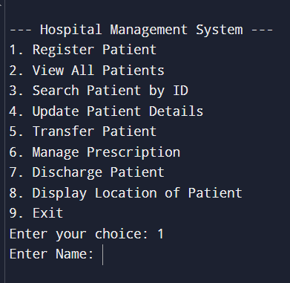
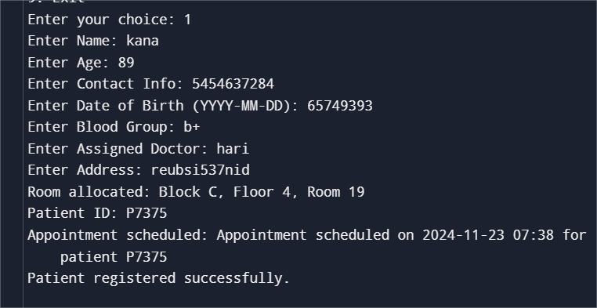
Results and Discussion

Slide 13
Results and Discussion(Cont..)
Discussion :
The system demonstrates a modular and efficient approach for managing essential hospital operations, including patient registration, room allocation, prescription management, and discharge processes. It is effective for small-scale use, offering a clear and interactive CLI interface. However, the system has some limitations. The lack of data persistence means that all records are lost upon exiting the program, making it unsuitable for long-term use without integration with a database.
Randomized billing, while functional for demonstration purposes, does not reflect actual patient expenses and would need to be replaced with accurate, service-based calculations for real-world applications. Limited input validation increases the risk of errors or invalid data being entered. Additionally, the fixed hospital layout limits scalability, making it challenging to adapt to larger facilities.
Future enhancements such as persistent storage, a realistic billing module, advanced validation, and a graphical user interface (GUI) would significantly improve usability, reliability, and scalability, allowing the system to serve medium- to large-sized hospitals effectively.

Slide 14
Conclusion
The Hospital Management System provides a functional foundation for managing patient data, room allocation, prescriptions, and discharge processes. It offers an interactive and modular approach, making it user-friendly for hospital administrators. While the system is effective for small-scale operations, its reliance on in-memory data storage and randomized billing limits its real-world applicability.
By incorporating persistent storage, advanced input validation, and a scalable architecture, the system can be enhanced to meet the demands of medium- to large-scale hospitals. Overall, the code serves as a strong starting point for a more comprehensive and efficient hospital management solution.

Slide 15
REFERENCES
1.Elmasri, R., & Navathe, S. B. (2016). Fundamentals of Database Systems (7th Edition). Pearson.
This book provided foundational knowledge for structuring and managing data systematically, which influenced the design of the patients dictionary and room allocation logic in the code.
2.Kanetkar, Y. (2019). Let Us Python: Python Is Future, Embrace It Fast. BPB Publications.
Concepts on Python programming basics, including CLI design and modular programming, were referenced to build the interactive functionalities of the system.
3.Goyal, M. (2016). Hospital Management and Administration: Principles and Practice. CBS Publishers & Distributors.
Helped understand real-world hospital workflows like patient registration, room allocation, and billing, which were modeled into the system.
4.Tiwari, A., & Goyal, A. (2020). Practical Python Programming. McGraw Hill.
Provided practical examples and guidance on implementing Python programs with user input, error handling, and modular design.

Slide 16
Thank You
Any queries???

